Slide 1

4.1 Marketing Management 4.2 Financial Management
Marketing Management:-the 4 p’s of marketing, demand forecasting (concepts only), market segmentation.
Financial management:-meaning, scope, functions, objectives, role of financial manager.
Lean Systems,
Intellectual Property, Legal Issues in Engineering Management,
Principles of Ethics for Engineering Managers

Slide 2
Marketing Management
Marketing management is the process of decision making, planning, and controlling the marketing aspects of a company in terms of the marketing concept, somewhere within the marketing system.
Marketing management is “planning, organising, controlling and implementing of marketing programmes, policies, strategies and tactics designed to create and satisfy the demand for the firms’ product offerings or services as a means of generating an acceptable profit.”

Slide 3
Marketing management
It deals with creating and regulating the demand and providing goods to customers for which they are willing to pay a price worth their value.
Marketing Management performs all managerial functions in the field of marketing.
Marketing Management identifies market opportunities and comes out with appropriate strategies for exploring those opportunities profitably. It has to implement marketing programme and evaluate continuously the effectiveness of marketing. It has to remove the deficiencies observed in the actual execution of marketing plans, policies, and procedures.

Slide 4
Marketing Management
According to Philip Kotler, “Marketing Management is the art and science of choosing target markets and building profitable relationship with them. Marketing management is a process involving analysis, planning, implementing and control and it covers goods, services, ideas and the goal is to produce satisfaction to the parties involved”.
Marketing Management is the process of management of marketing programmes for accomplishing organizational goals and objectives.

Slide 5
Marketing Management
Marketing Management Involves:
1. The setting of marketing goals and objectives,
2. Developing the marketing plan,
3. Organising the marketing function,
4. Putting the marketing plan into action and
5. Controlling the marketing programme.

Slide 6
Features of marketing concept
The following are the features of marketing concept (modern marketing concept, integrated marketing concept, customer orientation):
i. Focus on customer needs – The needs of the consumer are studied and these become the basis of all product related activities such as designing, pricing, distribution, packaging etc.
ii. Providing consumer satisfaction – Every organization aims at providing maximum consumer satisfaction by understanding his needs and designing an appropriate product. The success of an organization is directly related to the consumer satisfaction it provides.
iii. Integrated Marketing Management – Marketing management is only a part of the total managerial functions of an organization such as finance management, production management, human resources management etc. All these functions are integrated in order to provide maximum satisfaction to the consumer.

Slide 7
Features of marketing concept
iv. Achieving organizational goals – Modern marketing states that an organization must aim at maximizing consumer satisfaction and in the process enable itself to achieve its goals such as growth, market share and reasonable amount of profit or return on investment.
v. Innovation – Innovation is an important tool to provide consumer satisfaction. Innovative methods must be used to understand the consumer, design an appropriate product and offer it to the consumer.

Slide 8
Importance of Marketing Management
Marketing management smoothen the process of exchange of ownership of goods and services from seller to the buyer.
1. Analyzing Market Opportunities:
Marketing management collects and analyses information related to consumer’s needs, wants and demands, competitor’s marketing strategies, changing market trends and preferences. This helps to identify market opportunities.
2. Determination of Target Market:
Marketing management helps to identify the target market that the organization wishes to offer its product.
3. Planning and Decision Making:
Marketing management helps to prepare future course of action. Planning relates to product introduction, diversification. Decision making regarding pricing, selection of promotional mix, selection of distribution channel is taken by the marketing management.

Slide 9
Importance of Marketing Management
4. Creation of Customer:
Consumers determine the future of the market .Therefore providing the best product to the consumer according to their preference is the important task of marketing. Marketing management helps in creation of new customers and retention of current customers.
5. Helps in Increasing Profit:
Marketing provides to the varied and unlimited needs of consumers. Marketing management helps to increase profit and sales volume. This is achieved by expansion of market and increasing customers.

Slide 10
Importance of Marketing Management
6. Improvement in Quality of Life:
Marketing management aims at providing innovative product and services to the customers. Marketers continuously strive to incorporate new technology and mechanism in their product to provide more satisfaction to customers than before. This improves quality of life and makes life of consumers easier than before.
7. Employment Opportunities:
Marketing process is a combination of different activities like research work to assess the marketing environment, product planning and development, promotion, distribution of product to customers and after sales service. Marketing process requires researcher, production engineer, different distribution intermediaries, sales personnel also creates employment opportunities in advertisement section.

Slide 11
Marketing Management Functions
Assessing the Marketing Opportunities, Planning the Marketing Activities, Organising the Marketing Activities and a Few Others
Marketing is related to markets and therefore marketing management calls for integration of the various elements of market. It has the task of organising these elements into an effective operating system so that it can serve both customer and business enterprise effectively.
Various functions of marketing management are:
1. Assessing the Marketing Opportunities:
Determination of marketing objectives and assessment of the marketing opportunities for the firm, is an important function of marketing management. The constantly changing market conditions and opportunities make it imperative for the marketing management to come out with planned progammes to meet the challenges, and reap the opportunities.

Slide 12
Marketing Management Functions
2. Planning the Marketing Activities:
Planning is an important managerial function. Planning of marketing activities is a crucial task and involves numerous steps. It is concerned with formulation of policies relating to product, price, channels of distribution, promotional measures, forecast of target sales etc.
3. Organising the Marketing Activities:
Another significant function of marketing is organising it implies determination of various activities to be performed and assigning these activities to right person, so that marketing objectives are achieved. In the light of the changing concept of marketing, it is necessary that the organisation structure is flexible and accommodative.
4. Co-Ordinating Different Activities of Enterprise:
Even the best of planning will not be rewarding if there is improper coordination between different activities of the organisation. Marketing involves various activities and these are inter-related and interdependent. Product decisions, pricing strategies, channel structure research activities all require proper coordination. Only then the objectives can be achieved.

Slide 13
Marketing Management Functions
5. Directing and Motivating the Employee:
A good direction is a must for effective performance of marketing functions. Direction helps in rightful performance of the work. Different leadership style are practiced to guide the subordinates. A leader directs his subordinates and ensures through effective supervision. At the same time, it is necessary that employers are properly motivated. Motivation not only helps in better performance by the employee but also holds him back to the organisation for longer periods.
These days organizations are very serious as far as their motivation policies are concerned.

Slide 14
Marketing Management Functions
6. Evaluating and Controlling Marketing Efforts:
In order to have a profitable venture, marketing manager must on a continuous basis, evaluate the marketing efforts. This will help him in knowing the deficiencies if any.
Controlling is a managerial function concerned with comparison of actual performance with the standard performance and locating the shortcomings if any, finally corrective measures are taken to overcome the shortcomings.

Slide 15
4 P’s of Marketing
The “4 P’s of Marketing” refer to the four key elements comprising the process of marketing a product or service. They involve the marketing mix, which is a set of tools that a company uses to influence consumers into buying its product. The marketing mix addresses factors such as:
Understanding the needs or desires of consumers
Identifying the cause of the failure of the current product offering
Finding ways to solve said problems and change public perception of the product/service
Creating distinguishing characteristics to increase competitive advantage
Understanding how the product interacts with consumers and vice versa

Slide 16
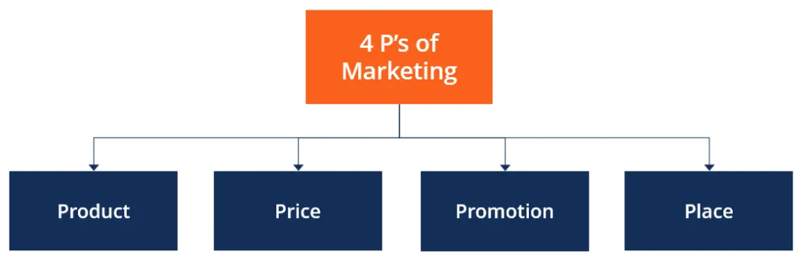
4 P’s of Marketing

Slide 17
4 P’s of Marketing
1. Product
A product is any good or service that fulfills consumer needs or desires. It can also be defined as a bundle of utilities that comes with physical aspects such as design, volume, brand name, etc. The type of product impacts its perceived value, which allows companies to price it profitably. It also affects other aspects such as product placement and advertisements.
Companies can change the packaging, after-sales service, warranties, and price range, or expand to new markets to meet their objectives. Marketers must understand the product life cycle and come up with strategies for every stage in the life cycle, i.e., introduction, growth, maturity, and decline.

Slide 18
4 P’s of Marketing
2. Price
The price of a product directly influences sales volume and, consequently, business profits. Demand, cost, pricing trends among competitors, and government regulations are crucial factors that determine pricing. Price usually reflects the product’s perceived value rather than its real value. This means that pricing can be increased to promote exclusivity or reduced to create access.
Thus, pricing involves making decisions in terms of the basic price, discounts, price alteration, credit terms, freight payments, etc.

Slide 19
4 P’s of Marketing
3. Promotion
Promotion involves decisions related to advertising, salesforce, direct marketing, public relations, advertising budgets, etc. The primary aim of promotion is to spread awareness about the product and services offered by a company. It helps in influence consumers to choose a particular product over others in the market. Promotional efforts include the following:
Advertising: A means of selling a product, service, or idea through communicating a sponsored, non-personal message about the product.
Public relations: Involves management and control of the flow and matter of information from one’s organization to the general public or other institutions.
Marketing strategy: Involves identifying the right target market and using tools such as advertising to penetrate the said market. Promotion also includes online factors such as determining the class of search functions on Google that may trigger corresponding or targeted ads for the product, the design and layout of a company’s webpage, or the content posted on social media handles such as Twitter and Instagram.

Slide 20
4 P’s of Marketing
4. Place (or Distribution)
Place involves choosing the place where products are to be made available for sale. The primary motive of managing trade channels is to ensure that the product is readily available to the customer at the right time and place. It also involves decisions regarding the placing and pricing of wholesale and retail outlets.
Distribution channels such as outsourcing or company transport fleets are decided upon after cost-benefit analysis. Small details such as shelf space committed to the product by department stores are also included.

Slide 21
Extensions to the 4 P’s of Marketing
New marketers recommend expanding the 4 P’s of Marketing to include services as well. They include:
People: Servicing involves a direct interaction of service providers and consumers, which increases the scope for subjectivity. Appearances, communication, discretion, consumer interaction, behavior, and attitude of service are important aspects.
Physical Evidence: Atmosphere, layout, and design of the workplace can largely impact the brand image of a product.
Process: Standardized procedures are usually adopted in cases of policy, procedures, systems, and consumer involvement to create continuity while delivering services.

Slide 22
Activities of Marketing:
Accordingly, proper marketing requires the following activities:
i. Analysis:
Marketing begins with identification of the market in which a marketer wants to enter.
It requires a detailed investigation and examination of various markets and selection of an attractive target.
Some of the aspects include opportunity identification by evaluating market size, growth rate, competition, distribution channels, profit potential, and other trends.
Market analysis is the first essential step in determining where the firm seeks to market its product or service.

Slide 23
Activities of Marketing:
ii. Planning:
Once the market has been selected, the marketer has to plan how it will satisfy customers in the selected market.
This requires planning about different marketing tools and their combinations that shall be mixed to achieve desired results.
Some important questions that need to be addressed include what product to make, its quality level, price to be charged, promotion elements, and how it will be made available. Essentially, marketing planning is about determining strategy that requires detailing the steps that would be undertaken to achieve the set marketing goals.

Slide 24
Activities of Marketing:
iii. Implementation:
Once planning is complete the marketer should move from drawing board to action. This requires organizing of marketing activities and their execution. For instance, a distribution plan execution of a company like Pepsi will include undertaking activities such as handling of cartons at factory, loading on trucks, transportation, and delivery at sale points.
iv. Control:
Control is needed to ensure that actual execution is done as planned. Deviations are possible due to a variety of factors. Therefore, keeping a track of the progress of marketing activities is required for achieving the marketing goals. For instance, brands are advertised to create awareness, the effectiveness of which is assessed through control mechanism such as recall and recognition measures. The deviations are then identified and corrective action is undertaken.

Slide 25
Demand Forecasting
Demand Forecasting is the process in which historical sales data is used to develop an estimate of an expected forecast of customer demand.
To businesses, Demand Forecasting provides an estimate of the amount of goods and services that its customers will purchase in the foreseeable future.
Critical business assumptions like turnover, profit margins, cash flow, capital expenditure, risk assessment and mitigation plans, capacity planning, etc. are dependent on Demand Forecasting.

Slide 26
Demand Forecasting types
Passive Demand Forecasting: Passive Demand Forecasting is carried out for stable businesses with very conservative growth plans. Simple extrapolations of historical data is carried out with minimal assumptions. This is a rare type of forecasting limited to small and local businesses.
Active Demand Forecasting: Active Demand Forecasting is carried out for scaling and diversifying businesses with aggressive growth plans in terms of marketing activities, product portfolio expansion and consideration of competitor activities and external economic environment.
Short-term Demand Forecasting: Short-term Demand Forecasting is carried out for a shorter term period of 3 months to 12 months. In the short term, the seasonal pattern of demand and the effect of tactical decisions on the customer demand are taken into consideration.

Slide 27
Demand Forecasting types
Medium to long-term Demand Forecasting: Medium to long-term Demand Forecasting is typically carried out for more than 12 months to 24 months in advance (36-48 months in certain businesses). Long-term Forecasting drives the business strategy planning, sales and marketing planning, financial planning, capacity planning, capital expenditure, etc.
External macro level Demand Forecasting: This type of Forecasting deals with the broader market movements which depend on the macroeconomic environment. External Forecasting is carried out for evaluating the strategic objectives of a business like product portfolio expansion, entering new customer segments, technological disruptions, a paradigm shift in consumer behavior and risk mitigation strategies.
Internal business level Demand Forecasting: As the name suggests, this type of Forecasting deals with internal operations of the business such as product category, sales division, financial division, and manufacturing group. This includes annual sales forecast, net profit margin, cash flow, etc.

Slide 28
Examples of Demand Forecasting
Some real-world practical examples of Demand Forecasting are – A leading car maker, refers to the last 12 months of actual sales of its cars at model, engine type, and color level; and based on the expected growth, forecasts the short-term demand for the next 12 month for purchase, production and inventory planning purposes.
A leading food manufacturing company refers to the last 24 months of actual sales of its highly seasonal products like soups and mashed potatoes. An analysis is carried out at the flavor and packaging size level. Then based on the market potential, demand is forecasted for the next 12 to 24 months for sourcing of key ingredients like tomatoes, potatoes, etc. and for capacity planning and evaluating the need for external co-packing.

Slide 29
Importance of Demand Forecasting
Demand Forecasting is the pivotal business process around which strategic and operational plans of a company are planned. Based on the Demand Forecast, strategic and long-range plans of a business like budgeting, financial planning, sales and marketing plans, capacity planning, risk assessment and mitigation plans are formulated.
Short to medium term tactical plans like pre-building, make-to-stock, make-to-order, contract manufacturing, supply planning, network balancing, etc. are execution based. Demand Forecasting also facilitates important management activities like decision making, performance evaluation, judicious allocation of resources in a constrained environment and business expansion planning.

Slide 30
Market segmentation
Market segmentation is the process of dividing a target market into smaller, more defined categories.
It segments customers and audiences into groups that share similar characteristics such as demographics, interests, needs, or location.

Slide 31
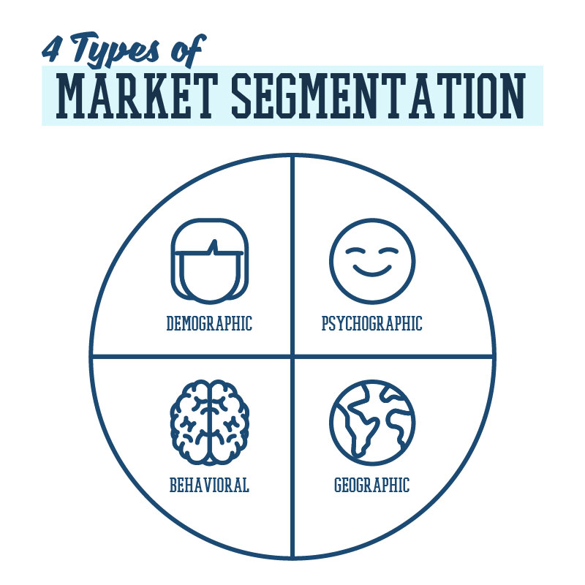
Market segmentation
The Four Types of Market Segmentation
The four bases of market segmentation are:
· Demographic segmentation
· Psychographic segmentation
· Behavioral segmentation
· Geographic segmentation
Within each of these types of market segmentation, multiple sub-categories further classify audiences and customers.

Slide 32
Market segmentation
Demographic Segmentation
Demographic segmentation is one of the most popular and commonly used types of market segmentation. It refers to statistical data about a group of people.
Demographic Market Segmentation Examples
Age ,Gender
Income ,Location
Family Situation ,
Annual Income
Education
Ethnicity

Slide 33
Market segmentation
Psychographic Segmentation
Psychographic segmentation categorizes audiences and customers by factors that relate to their personalities and characteristics.
Psychographic Market Segmentation Examples
Personality traits, Values
Attitudes, Interests
Lifestyles, Psychological influences
Subconscious and conscious beliefs
Motivations, Priorities
Psychographic segmentation factors are slightly more difficult to identify than demographics because they are subjective. They are not data-focused and require research to uncover and understand.

Slide 34
Market segmentation
Behavioral Segmentation
While demographic and psychographic segmentation focus on who a customer is, behavioral segmentation focuses on how the customer acts.
Behavioral Market Segmentation Examples
Purchasing habits, Spending habits
User status, Brand interactions
Behavioral segmentation requires you to know about your customer’s actions. These activities may relate to how a customer interacts with your brand or to other activities that happen away from your brand.
A B2C example in this segment may be the luxury car brand choosing to target customers who have purchased a high-end vehicle in the past three years. The B2B marketing platform may focus on leads who have signed up for one of their free webinars.

Slide 35
Market segmentation
Geographic Segmentation
Geographic segmentation is the simplest type of market segmentation. It categorizes customers based on geographic borders.
Geographic Market Segmentation Examples
ZIP code, City, Country, Radius around a certain location, Climate, Urban or rural
Geographic segmentation can refer to a defined geographic boundary (such as a city or ZIP code) or type of area (such as the size of city or type of climate).
An example of geographic segmentation may be the luxury car company choosing to target customers who live in warm climates where vehicles don’t need to be equipped for snowy weather. The marketing platform might focus their marketing efforts around urban, city centers where their target customer is likely to work.

Slide 36
Eight Benefits of Market Segmentation
Eight Benefits of Market Segmentation
The importance of market segmentation is that it makes it easier to focus marketing efforts and resources on reaching the most valuable audiences and achieving business goals.
Market segmentation allows you to get to know your customers, identify what is needed in your market segment, and determine how you can best meet those needs with your product or service. This helps you design and execute better marketing strategies from top to bottom.

Slide 37
Eight Benefits of Market Segmentation
1. Create stronger marketing messages
When you know whom you’re talking to, you can develop stronger marketing messages. You can avoid generic, vague language that speaks to a broad audience. Instead, you can use direct messaging that speaks to the needs, wants, and unique characteristics of your target audience.
2. Identify the most effective marketing tactics
With dozens of marketing tactics available, it can be difficult to know what will attract your ideal audience. Using different types of market segmentation guides you toward the marketing strategies that will work best. When you know the audience you are targeting, you can determine the best solutions and methods for reaching them.

Slide 38
Eight Benefits of Market Segmentation
3. Design hyper-targeted ads
On digital ad services, you can target audiences by their age, location, purchasing habits, interests, and more. When you use market segmentation to define your audience, you know these detailed characteristics and can use them to create more effective, targeted digital ad campaigns.
4. Attract (and convert) quality leads
When your marketing messages are clear, direct, and targeted they attract the right people. You draw in ideal prospects and are more likely to convert potential customers into buyers.

Slide 39
Eight Benefits of Market Segmentation
5. Differentiate your brand from competitors
Being more specific about your value propositions and messaging also allows you to stand out from competitors. Instead of blending in with other brands, you can differentiate your brand by focusing on specific customer needs and characteristics.
6. Build deeper customer affinity
When you know what your customers want and need, you can deliver and communicate offerings that uniquely serve and resonate with them . This distinct value and messaging leads to stronger bonds between brands and customers and creates lasting brand affinity.

Slide 40
Eight Benefits of Market Segmentation
7. Identify niche market opportunities
Niche marketing is the process of identifying segments of industries and verticals that have a large audience that can be served in new ways.
When you segment your target market, you can find underserved niche markets that you can develop new products and services for.
8. Stay focused
Targeting in marketing keeps your messaging and marketing objectives on track.
It helps you identify new marketing opportunities and avoid distractions that will lead you away from your target market.

Slide 41
FINANCIAL MANAGEMENT

Slide 42
Meaning of Financial Management
Financial Management means planning, organizing, directing and controlling the financial activities such as procurement and utilization of funds of the enterprise.
It means applying general management principles to financial resources of the enterprise.

Slide 43
Scope/Elements
1.Investment decisions includes investment in fixed assets (called as capital budgeting). Investment in current assets are also a part of investment decisions called as working capital decisions.
2.Financial decisions - They relate to the raising of finance from various resources which will depend upon decision on type of source, period of financing, cost of financing and the returns thereby.
3.Dividend decision - The finance manager has to take decision with regards to the net profit distribution. Net profits are generally divided into two:
a.Dividend for shareholders- Dividend and the rate of it has to be decided.
b.Retained profits- Amount of retained profits has to be finalized which will depend upon expansion and diversification plans of the enterprise.

Slide 44
Objectives of Financial Management
The financial management is generally concerned with procurement, allocation and control of financial resources of a concern.
The objectives can be-
1.To ensure regular and adequate supply of funds to the concern.
2.To ensure adequate returns to the shareholders which will depend upon the earning capacity, market price of the share, expectations of the shareholders.
3.To ensure optimum funds utilization. Once the funds are procured, they should be utilized in maximum possible way at least cost.
4.To ensure safety on investment, i.e, funds should be invested in safe ventures so that adequate rate of return can be achieved.
5.To plan a sound capital structure-There should be sound and fair composition of capital so that a balance is maintained between debt and equity capital.

Slide 45
Functions of Financial Management
1.Estimation of capital requirements: A finance manager has to make estimation with regards to capital requirements of the company. This will depend upon expected costs and profits and future programmes and policies of a concern. Estimations have to be made in an adequate manner which increases earning capacity of enterprise.
2..Determination of capital composition: Once the estimation have been made, the capital structure have to be decided. This involves short- term and long- term debt equity analysis. This will depend upon the proportion of equity capital a company is possessing and additional funds which have to be raised from outside parties.
3.Choice of sources of funds: For additional funds to be procured, a company has many choices like-
1.Issue of shares and debentures
2.Loans to be taken from banks and financial institutions
3.Public deposits to be drawn like in form of bonds.

Slide 46
Functions of Financial Management
Choice of factor will depend on relative merits and demerits of each source and period of financing.
4.Investment of funds:
The finance manager has to decide to allocate funds into profitable ventures so that there is safety on investment and regular returns is possible.
5.Disposal of surplus:
The net profits decision have to be made by the finance manager. This can be done in two ways:
1.Dividend declaration - It includes identifying the rate of dividends and other benefits like bonus.
2.Retained profits - The volume has to be decided which will depend upon expansional, innovational, diversification plans of the company.

Slide 47
Functions of Financial Management
6.Management of cash:
Finance manager has to make decisions with regards to cash management. Cash is required for many purposes like payment of wages and salaries, payment of electricity and water bills, payment to creditors, meeting current liabilities, maintainance of enough stock, purchase of raw materials, etc.
7.Financial controls:
The finance manager has not only to plan, procure and utilize the funds but he also has to exercise control over finances. This can be done through many techniques like ratio analysis, financial forecasting, cost and profit control, etc.

Slide 48
Role of a Financial Manager
Financial activities of a firm is one of the most important and complex activities of a firm. Therefore in order to take care of these activities a financial manager performs all the requisite financial activities.
A financial manger is a person who takes care of all the important financial functions of an organization.
The person in charge should maintain a far sightedness in order to ensure that the funds are utilized in the most efficient manner. His actions directly affect the Profitability, growth and goodwill of the firm.

Slide 49
Role of a Financial Manager
Following are the main functions of a Financial Manager:
Raising of Funds
In order to meet the obligation of the business it is important to have enough cash and liquidity. A firm can raise funds by the way of equity and debt. It is the responsibility of a financial manager to decide the ratio between debt and equity. It is important to maintain a good balance between equity and debt.
Allocation of Funds
Once the funds are raised through different channels the next important function is to allocate the funds. The funds should be allocated in such a manner that they are optimally used. In order to allocate funds in the best possible manner the following point must be considered
The size of the firm and its growth capability
Status of assets whether they are long-term or short-term
Mode by which the funds are raised

Slide 50
Role of a Financial Manager
These financial decisions directly and indirectly influence other managerial activities. Hence formation of a good asset mix and proper allocation of funds is one of the most important activity
Profit Planning
Profit earning is one of the prime functions of any business organization. Profit earning is important for survival and sustenance of any organization. Profit planning refers to proper usage of the profit generated by the firm.
Profit arises due to many factors such as pricing, industry competition, state of the economy, mechanism of demand and supply, cost and output. A healthy mix of variable and fixed factors of production can lead to an increase in the profitability of the firm.

Slide 51
Role of a Financial Manager
Fixed costs are incurred by the use of fixed factors of production such as land and machinery. In order to maintain a tandem it is important to continuously value the depreciation cost of fixed cost of production. An opportunity cost must be calculated in order to replace those factors of production which has gone thrown wear and tear. If this is not noted then these fixed cost can cause huge fluctuations in profit.
Understanding Capital Markets
Shares of a company are traded on stock exchange and there is a continuous sale and purchase of securities. Hence a clear understanding of capital market is an important function of a financial manager. When securities are traded on stock market there involves a huge amount of risk involved. Therefore a financial manger understands and calculates the risk involved in this trading of shares and debentures.
Its on the discretion of a financial manager as to how to distribute the profits. Many investors do not like the firm to distribute the profits amongst share holders as dividend instead invest in the business itself to enhance growth. The practices of a financial manager directly impact the operation in capital market.

Slide 52
Assignment 4.1/4.2
Q 1. Explain the features and importance of marketing Management.
Q 2. Elaborate the role of a Financial Manager.
Q 3. Explain 4 P’s of marketing.
Q 4. What is demand forcasting ? Explain its types.
Q 5. What is market segmentation. Explain its eight benefits.
Q 6. Explain the elements of financial management.

